Slide 1


Path Module

Slide 2
List of content:
NodeJS path module

Slide 3
NodeJS path module
Node.js provides you with the path module that allows you to interact with file paths easily.
The path module has many useful properties and methods to access and manipulate paths in the file system.

Slide 4
Useful path properties
The path object has the sep property that represents the platform-specific path separator

Slide 5
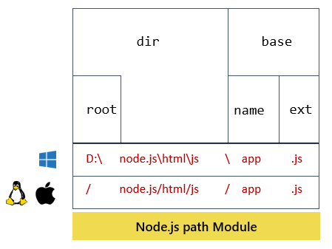
Path module

Slide 6
Handy path methods
The following shows some handy methods of the path module that you probably use very often.
path.basename(path, [,ext])
path.dirname(path)
path.extname(path)
path.format(pathObj)
path.isAbsolute(path)
path.join(...path)
path.normalize(path)
path.parse(path)
path.relative(from, to)
path.resolve(...path)

Slide 7
THANK YOU

